Slide 1
20 October 2016 Foster Wheeler 1200 LB Steam Boiler

Slide 2
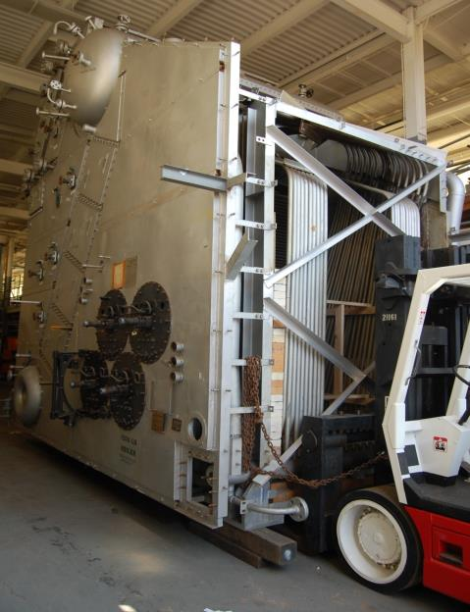

Slide 3
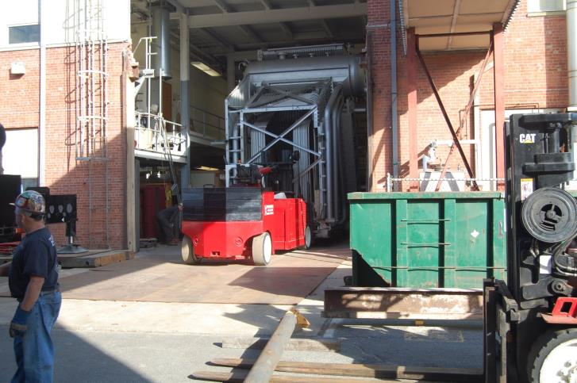

Slide 4
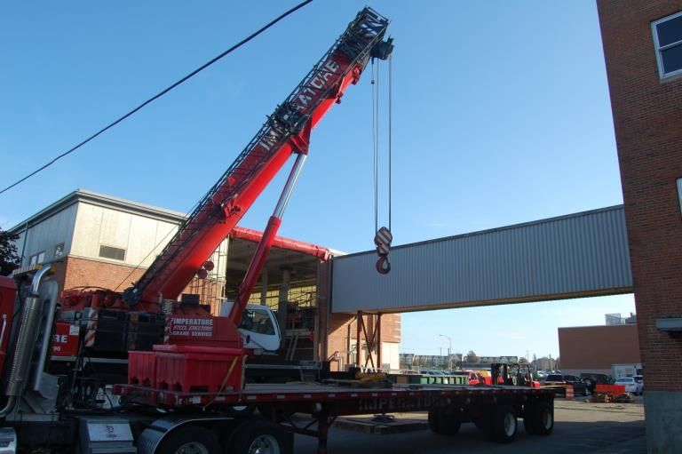

Slide 5
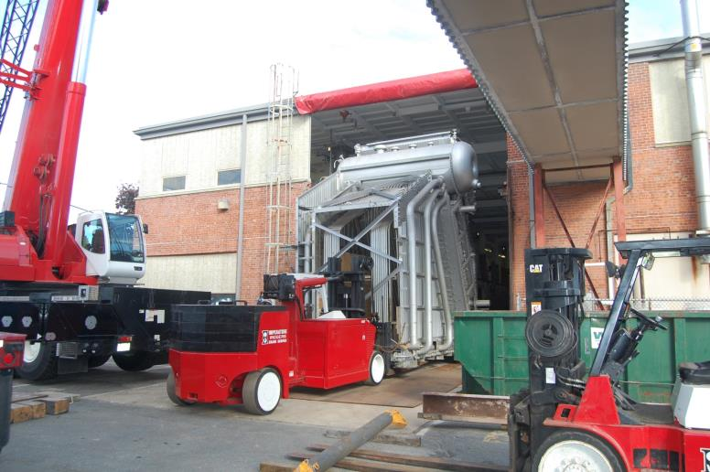

Slide 6
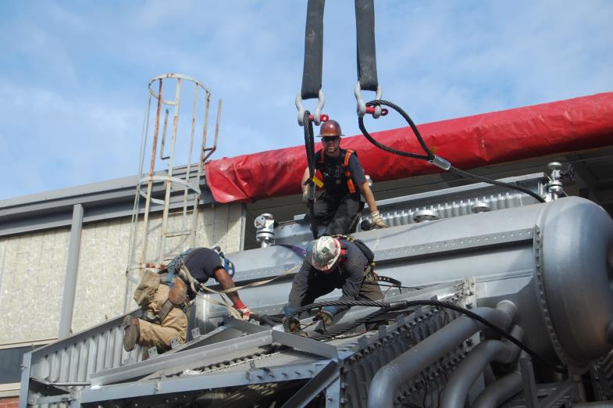

Slide 7
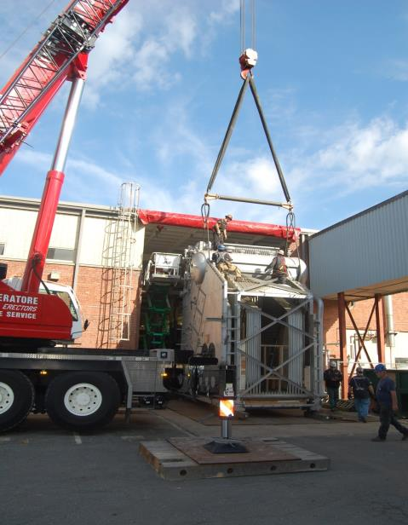

Slide 8
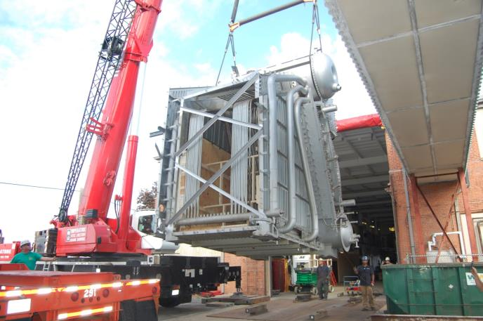

Slide 9
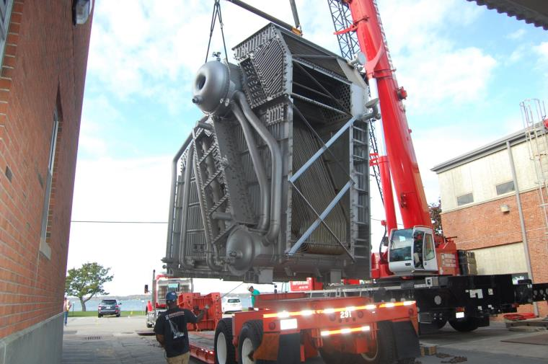

Slide 10
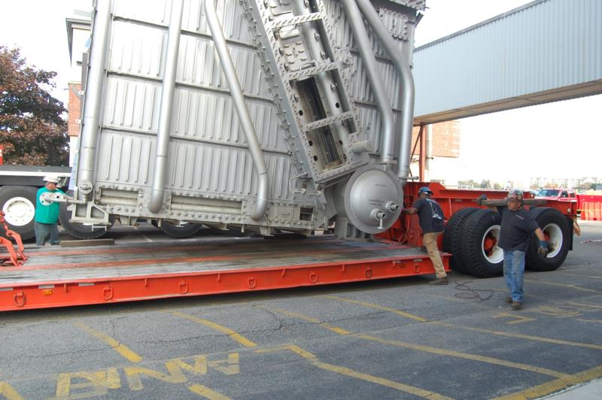

Slide 11
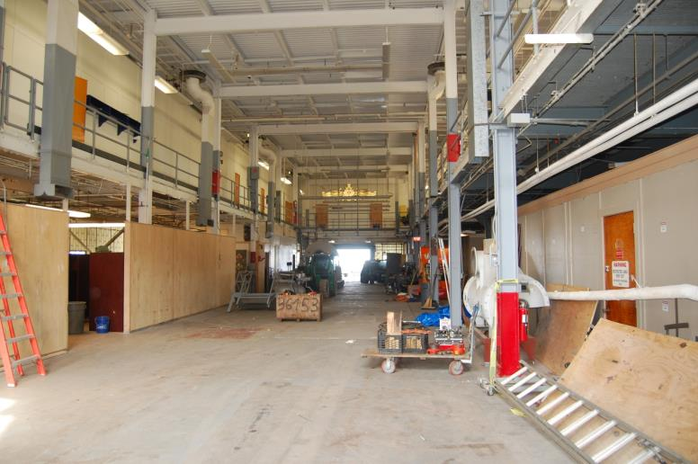
ALL GONE

Slide 12
Boiler Moving Day 22 October 2016
Started at 0630 leaving SWOS and arrived at pier 1100

Slide 13
Last measurement 22 ft. 3 in.

Slide 14
Over the bridge

Slide 15
First major hurdle

Slide 16
Over 4 in cable

Slide 17
Can’t make it over the 4 in cable

Slide 18
Still can’t make it over the cable

Slide 19
4 in. cable

Slide 20
Back up and try again

Slide 21
Lift 4 in. cable

Slide 22
Three hours later, approaching pier; Verizon life truck ran out of fuel (can’t make this stuff up) and could not get under last set of wires.

Slide 23
Approaching pier

Slide 24
Barge and tug waiting

Slide 25
Arrived at pier

Slide 26
Removing Tarp

Slide 27
Ready for lift

Slide 28
95,000 lb lift

Slide 31
Over barge 1100

Slide 32
Closing remarks
Towed to Quonset Point (Reagan Construction) awaiting favorable weather.
Barge schedule to depart for MMA on Wednesday. Estimate travel time is 12 hours.

